Slide 1
The Beginning of the Gospel
The Book of Mark
2024 Quarter 3 Lesson 01

Slide 2
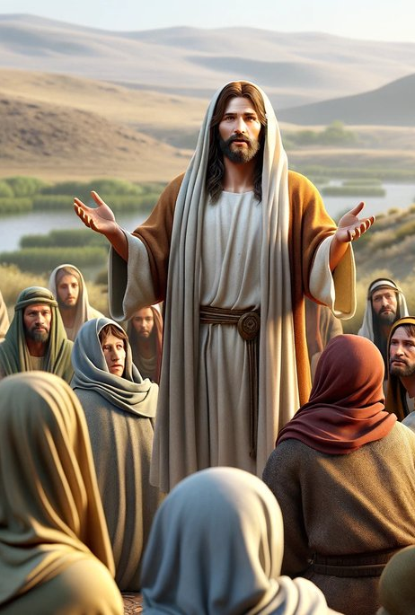
Memory Text: Mark 1:14-15
Now after that John was put in prison, Jesus came into Galilee, preaching the gospel of the kingdom of God, And saying, The time is fulfilled, and the kingdom of God is at hand: repent ye, and believe the gospel.

Slide 3
Who’s Mark?
“The unanimous and consistent testimony of Christian tradition points to John Mark as the author of the Gospel that bears his name. The name Mark is from the Latin Marcus, and is the surname of the writer.”
From the SDA Bible Commentary Volume 5

Slide 4
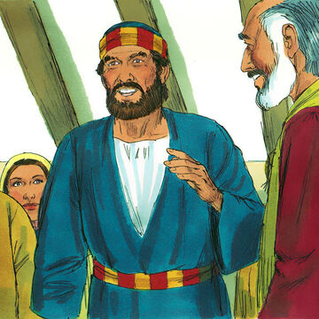
Who’s Mark?
Acts 12:11-12
11 And when Peter was come to himself, he said, Now I know of a surety, that the Lord hath sent his angel, and hath delivered me out of the hand of Herod, and from all the expectation of the people of the Jews.
12 And when he had considered the thing, he came to the house of Mary the mother of John, whose surname was Mark; where many were gathered together praying.

Slide 5
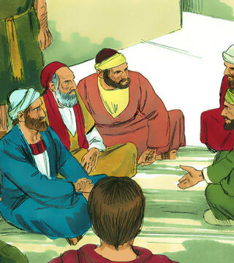
Who’s Mark?
His full name was John Mark, and his mother’s name was Mary. She seems to have been a wealthy supporter of the church and held the prayer meeting of Acts 12 at her home.

Slide 6
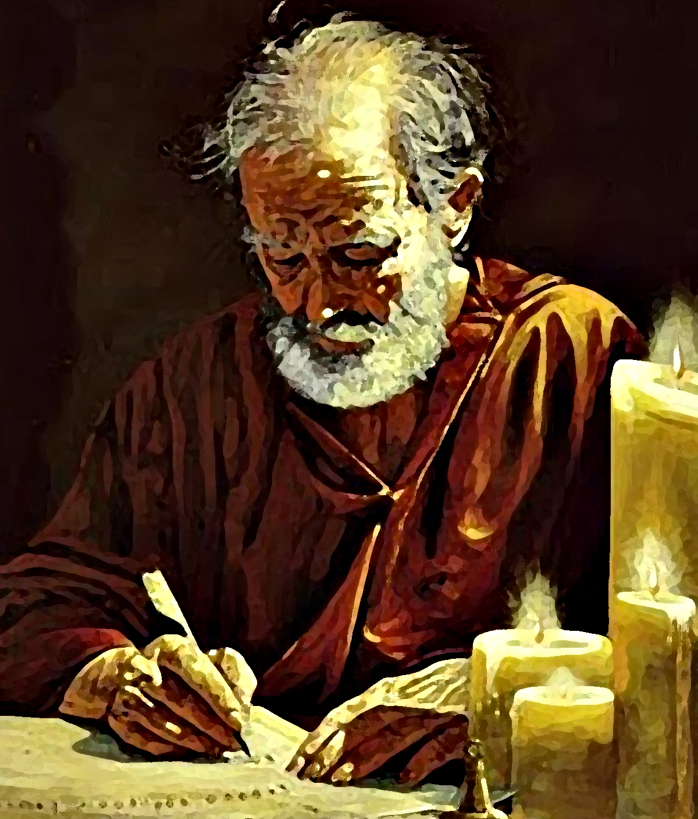
Who’s Mark?
Colossians 4:10
10 Aristarchus my fellowprisoner saluteth you, and Marcus, sister's son to Barnabas, (touching whom ye received commandments: if he come unto you, receive him;)

Slide 7
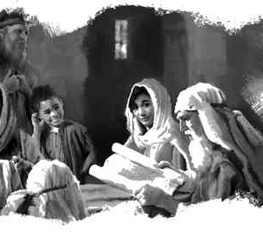
Who’s Mark?
Acts 4:36-37
36 And Joses, who by the apostles was surnamed Barnabas, (which is, being interpreted, The son of consolation,) a Levite, and of the country of Cyprus,
37 Having land, sold it, and brought the money, and laid it at the apostles' feet.

Slide 8
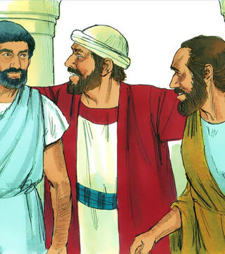
Who’s Mark?
Mark was a cousin of Barnabas (Col. 4:10), who was a Levite and at one time had been a resident of the island of Cyprus.

Slide 9
Who’s Mark?
Mark’s home in Jerusalem seems to have been the house in which was the “upper room,” where, for a time at least, some of the apostles lived after the resurrection and the ascension (John 20:19; Acts 1:13), and where members of the early church in Jerusalem assembled.
From the SDA Bible Commentary Volume 5

Slide 10
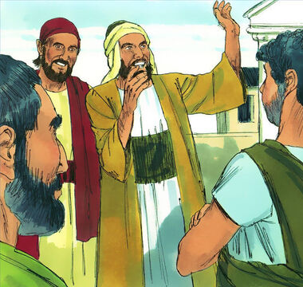
Who’s Mark?
Acts 13:1-5
13 Now there were in the church that was at Antioch certain prophets and teachers; as Barnabas, and Simeon that was called Niger, and Lucius of Cyrene, and Manaen, which had been brought up with Herod the tetrarch, and Saul.

Slide 11
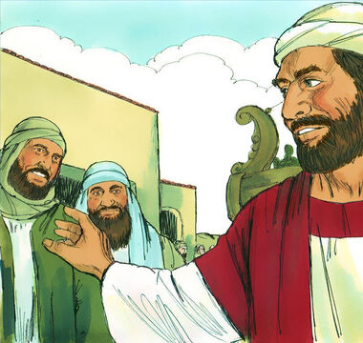
Who’s Mark?
Acts 13:2-5
2 As they ministered to the Lord, and fasted, the Holy Ghost said, Separate me Barnabas and Saul for the work whereunto I have called them.
3 And when they had fasted and prayed, and laid their hands on them, they sent them away.

Slide 12
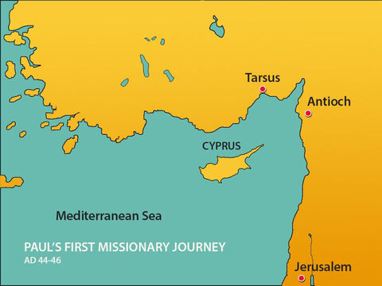
Who’s Mark?
Acts 13:4-5
4 So they, being sent forth by the Holy Ghost, departed unto Seleucia; and from thence they sailed to Cyprus.

Slide 13
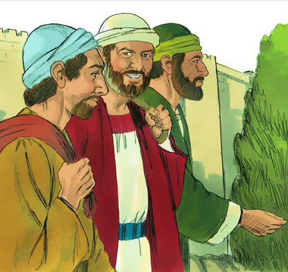
Who’s Mark?
Acts 13:5
5 And when they were at Salamis, they preached the word of God in the synagogues of the Jews: and they had also John to their minister.

Slide 14
Who’s Mark?
Mark traveled with Paul and Barnabas on Paul’s first missionary journey, and he seems to have been a helper or a servant. But Mark quickly returns to Jerusalem.

Slide 15
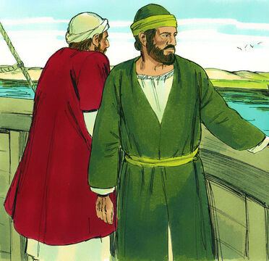
Who’s Mark?
Acts 13:5
13 Now when Paul and his company loosed from Paphos, they came to Perga in Pamphylia: and John departing from them returned to Jerusalem.

Slide 16
Who’s Mark?
“Mark, overwhelmed with fear and discouragement, wavered for a time in his purpose to give himself wholeheartedly to the Lord’s work. Unused to hardships, he was disheartened by the perils and privations of the way.”
Acts of the Apostles pg. 169

Slide 17
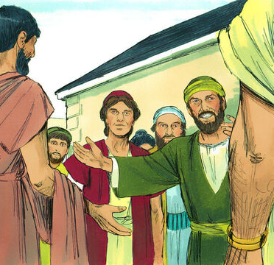
Who’s Mark?
Acts 15:36-41
36 And some days after Paul said unto Barnabas, Let us go again and visit our brethren in every city where we have preached the word of the Lord, and see how they do.
37 And Barnabas determined to take with them John, whose surname was Mark.

Slide 18
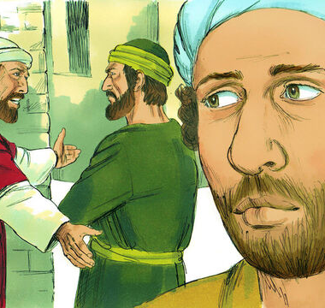
Who’s Mark?
Acts 15:36-41
38 But Paul thought not good to take him with them, who departed from them from Pamphylia, and went not with them to the work.
39 And the contention was so sharp between them, that they departed asunder one from the other: and so Barnabas took Mark, and sailed unto Cyprus;

Slide 19
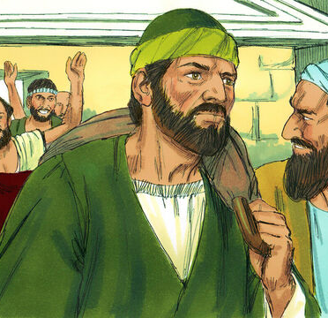
Who’s Mark?
Acts 15:36-41
40 And Paul chose Silas, and departed, being recommended by the brethren unto the grace of God.
41 And he went through Syria and Cilicia, confirming the churches.

Slide 20
From the SDA Bible Commentary
“Undoubtedly it was Barnabas’ family relationship with John Mark that led him to wish to take the young man once more on a missionary tour, to give him an opportunity to show his fitness for service. To Paul, the earnest and courageous warrior for Christ, anyone who had so acted seemed, in the Lord’s own words, not “fit for the kingdom of God,” and was in need of discipline, of rejection at least for a time, to fit himself for further work.”

Slide 21
Who’s Mark?
Fortunately, several verses in his letters reveal that Paul once more received John Mark as a fellow worker, even learning to recognize in John Mark one who was “profitable” to him “for the ministry.”
SDA Bible Commentaries Volume 6

Slide 22
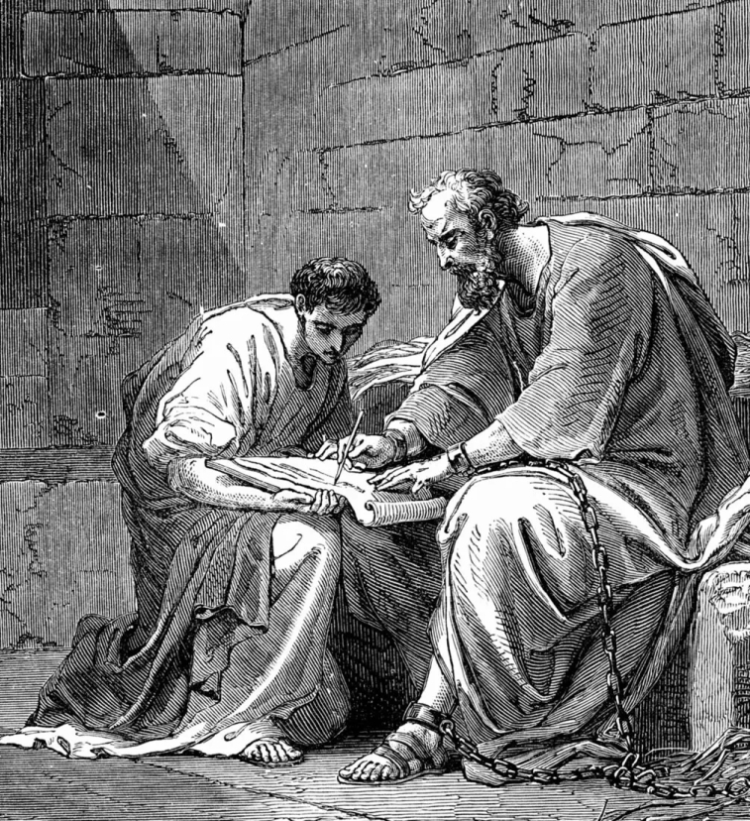
Who’s Mark?
Colossians 4:10-11
10 Aristarchus my fellowprisoner saluteth you, and Marcus, sister's son to Barnabas, (touching whom ye received commandments: if he come unto you, receive him;)
11 And Jesus, which is called Justus, who are of the circumcision. These only are my fellowworkers unto the kingdom of God, which have been a comfort unto me.

Slide 23
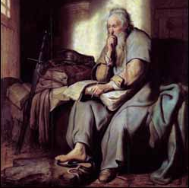
Who’s Mark?
Colossians 4:10-11
24 Marcus, Aristarchus, Demas, Lucas, my fellowlabourers.
25 The grace of our Lord Jesus Christ be with your spirit. Amen.

Slide 24
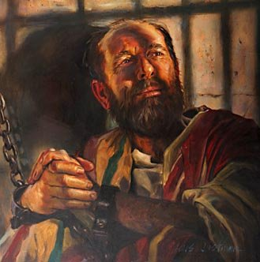
Who’s Mark?
2 Timothy 4:9-11
9 Do thy diligence to come shortly unto me:
10 For Demas hath forsaken me, having loved this present world, and is departed unto Thessalonica; Crescens to Galatia, Titus unto Dalmatia.
11 Only Luke is with me. Take Mark, and bring him with thee: for he is profitable to me for the ministry.

Slide 25
Who’s Mark?
After working with Barnabas in Cyprus, Mark apparently returned to Peter, and was with him in Rome. It may have been in connection with this stay at Rome that Mark labored once more with Paul.
SDA Bible Commentaries Volume 6

Slide 26
Papias, bishop of the city of Hierapolis, about 10 mi. (16 km.) from Collossae and Laodicea in Asia Minor, is the first known writer who speaks of Mark as the author of the Gospel bearing the name Mark. In his Interpretations, as quoted in Eusebius ( Ecclesiastical History iii. 39. 15; Loeb ed., vol. 1 , p. 297), he states:
SDA Bible Commentary Volume 5, Intro to Mark

Slide 27
SDA Bible Commentary Volume 5, Intro to Mark
“And the Presbyter [most probably the presbyter John] used to say this, “Mark became Peter’s interpreter and wrote accurately all that he remembered, not, indeed, in order, of the things said or done by the Lord. For he had not heard the Lord, nor had he followed him, but later on, as I said, followed Peter, who used to give teaching as necessity demanded but not making, as it were, an arrangement of the Lord’s oracles, so that Mark did nothing wrong in thus writing down single points as he remembered them. For to one thing he gave attention, to leave out nothing of what he had heard and to make no false statements in them.’””

Slide 28
Papias’ report is taken generally to imply that Mark served as a translator for the apostle Peter when he addressed audiences in whose language he was not fluent, apparently on journeys in lands where Aramaic, Peter’s native tongue, was not spoken. However, see AA 40. Presumably, Mark translated Peter’s gospel account so often that he became familiar with it and thus was prepared to write the gospel narrative under inspiration of the Holy spirit.
SDA Bible Commentary Volume 5, Intro to Mark

Slide 29

Who’s Mark?
1 Peter 5:13-14
13 The church that is at Babylon, elected together with you, saluteth you; and so doth Marcus my son.
14 Greet ye one another with a kiss of charity. Peace be with you all that are in Christ Jesus. Amen.

Slide 30
Mark introduces the Gospel
Mark 1: 1-15

Slide 31
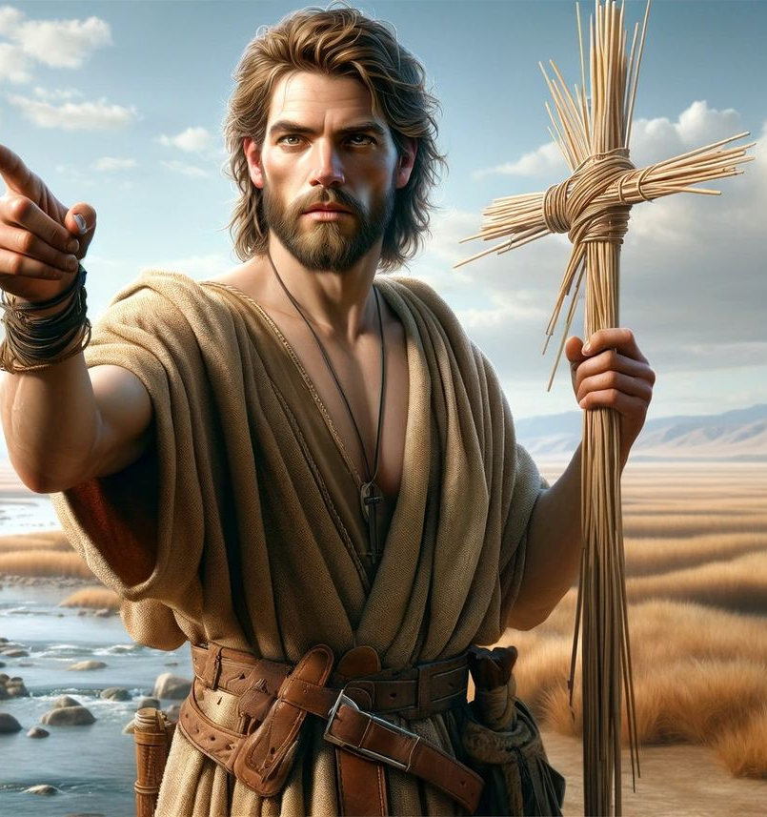
The Gospel:
Mark 1:1-15
1 The beginning of the gospel of Jesus Christ, the Son of God;
2 As it is written in the prophets, Behold, I send my messenger before thy face, which shall prepare thy way before thee.
3 The voice of one crying in the wilderness, Prepare ye the way of the Lord, make his paths straight.

Slide 32
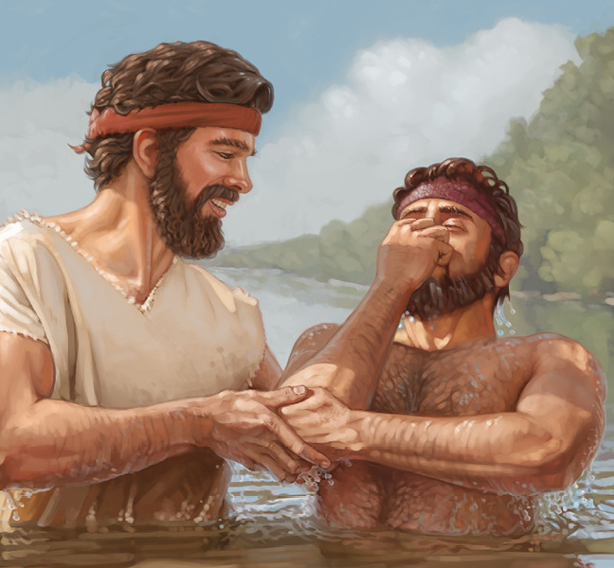
The Gospel:
Mark 1:4-15
4 John did baptize in the wilderness, and preach the baptism of repentance for the remission of sins.
5 And there went out unto him all the land of Judaea, and they of Jerusalem, and were all baptized of him in the river of Jordan, confessing their sins.

Slide 33
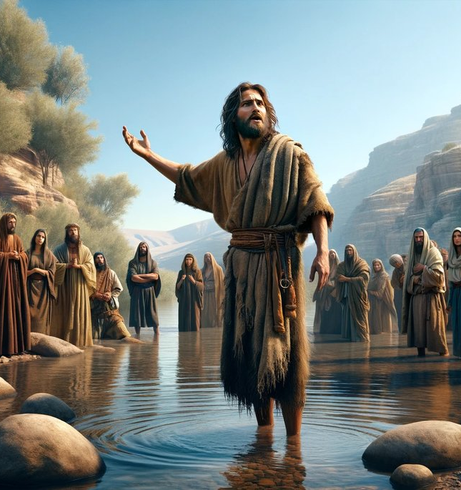
The Gospel:
Mark 1:6-15
6 And John was clothed with camel's hair, and with a girdle of a skin about his loins; and he did eat locusts and wild honey;
7 And preached, saying, There cometh one mightier than I after me, the latchet of whose shoes I am not worthy to stoop down and unloose.
8 I indeed have baptized you with water: but he shall baptize you with the Holy Ghost.

Slide 34
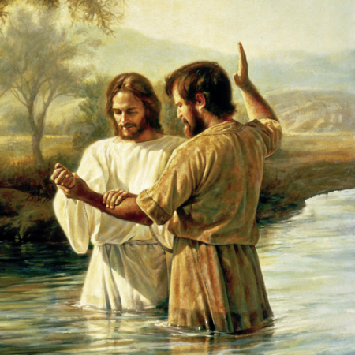
The Gospel:
Mark 1:6-15
9 And it came to pass in those days, that Jesus came from Nazareth of Galilee, and was baptized of John in Jordan.
10 And straightway coming up out of the water, he saw the heavens opened, and the Spirit like a dove descending upon him:
11 And there came a voice from heaven, saying, Thou art my beloved Son, in whom I am well pleased.

Slide 35
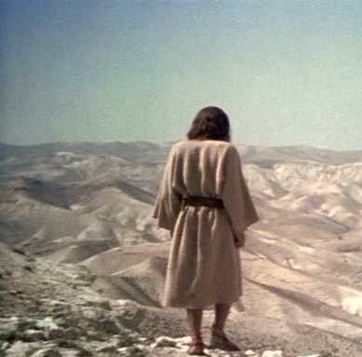
The Gospel:
Mark 1:6-15
12 And immediately the spirit driveth him into the wilderness.
13 And he was there in the wilderness forty days, tempted of Satan; and was with the wild beasts; and the angels ministered unto him.

Slide 36
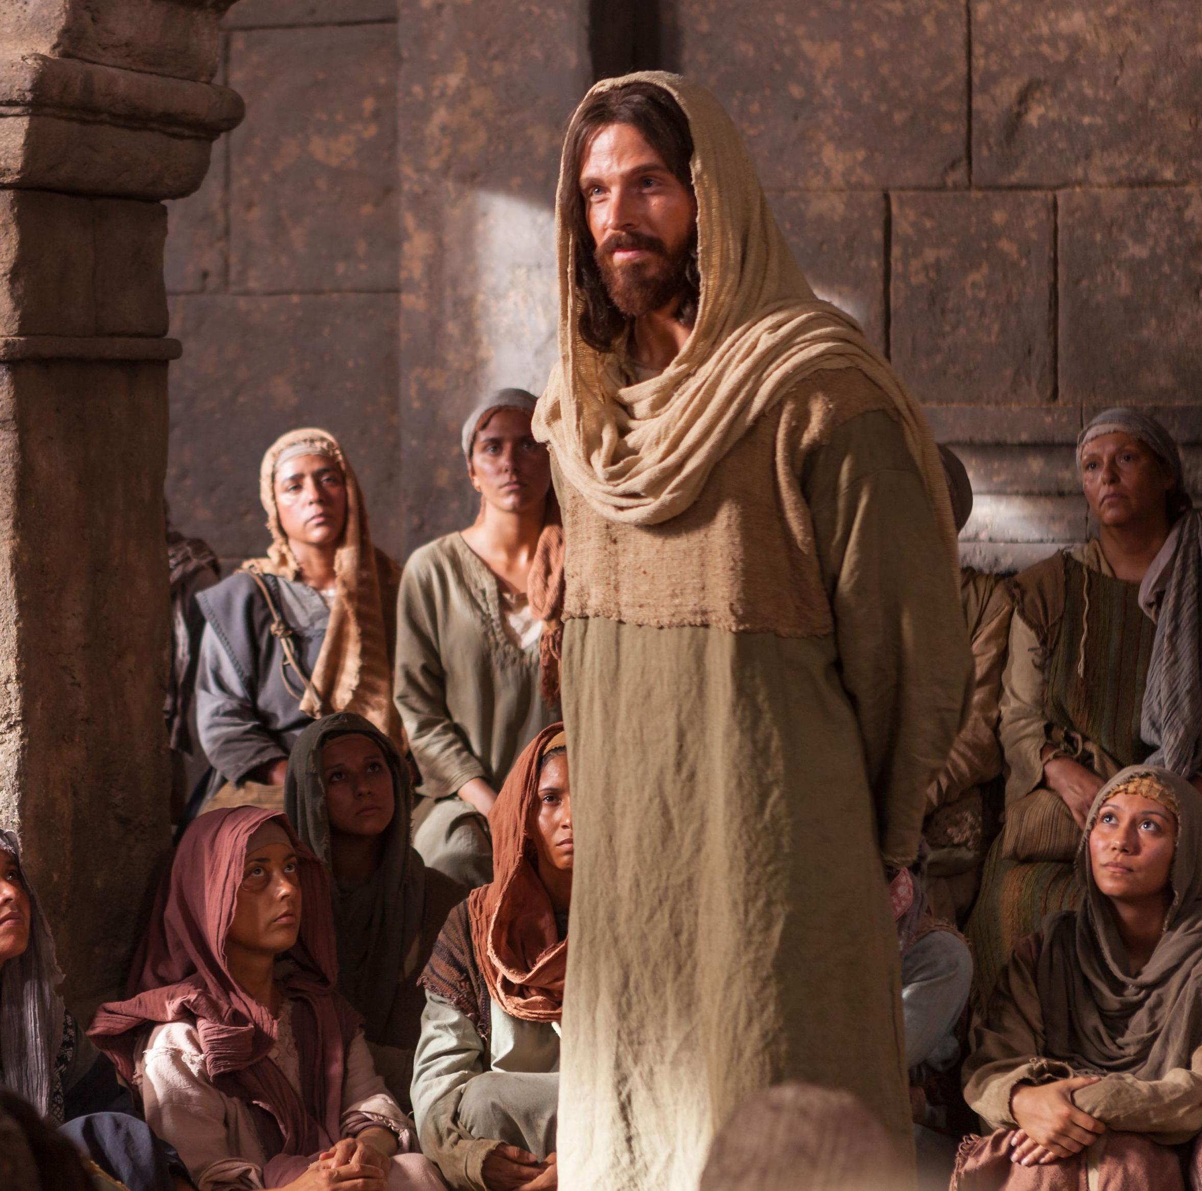
The Gospel:
Mark 1:6-15
14 Now after that John was put in prison, Jesus came into Galilee, preaching the gospel of the kingdom of God,
15 And saying, The time is fulfilled, and the kingdom of God is at hand: repent ye, and believe the gospel.

